Slide 1

Artificial language learning workshop: Lecture 1
James Brand
j.brand@lancaster.ac.uk

Slide 2
Overview
Artificial Language Learning
Outline
What you will learn in lecture 1:
What Artificial Language Learning (ALL) is
Why it is used in linguists research
How it is used in linguistics research
The validity of the paradigm

Slide 3
Overview
Artificial Language Learning
Outline
What you will learn in lecture 2:
Research that uses ALL to investigate word learning
Research that uses ALL to investigate grammar learning
Research that uses ALL to investigate reading
Research that uses ALL to investigate language evolution

Slide 4
Overview
Artificial Language Learning
Outline
What you will learn in lectures 3 and 4:
What it is like to take part in an ALL experiment
How to design ALL stimuli
How to program an ALL experiment in PsychoPy
How to interpret the data
Ways to design your own ALL experiment

Slide 5
Overview
Artificial Language Learning
What is artificial language learning?
Will I be learning about Valyrian, Dothraki, Klingon, Droidspeak etc.?
https://youtu.be/jJoAJyarvSc?t=10s

Slide 6
Overview
Artificial Language Learning
What is artificial language learning?
Will I be learning about Valyrian, Dothraki, Klingon, Droidspeak etc.?
https://youtu.be/jJoAJyarvSc?t=10s
NO

Slide 7
Overview
Artificial Language Learning
What is artificial language learning?
Will I be learning how to test predictions about the way language is learnt using carefully designed experiments?
YES

Slide 8
Overview
Artificial Language Learning
Why use artificial language learning?

Slide 9

Overview
Artificial Language Learning
Why use artificial language learning?

Slide 10
Overview
Artificial Language Learning
Why use artificial language learning?

Slide 11
Overview
Artificial Language Learning
Why use artificial language learning?
ALL is best used in conjunction with other empirical methods
Corpus analyses
Computational modelling
Naturalistic recordings
Individual differences

Slide 12
Overview
Artificial Language Learning
Why use artificial language learning?
The various forms of ALL…

Slide 13
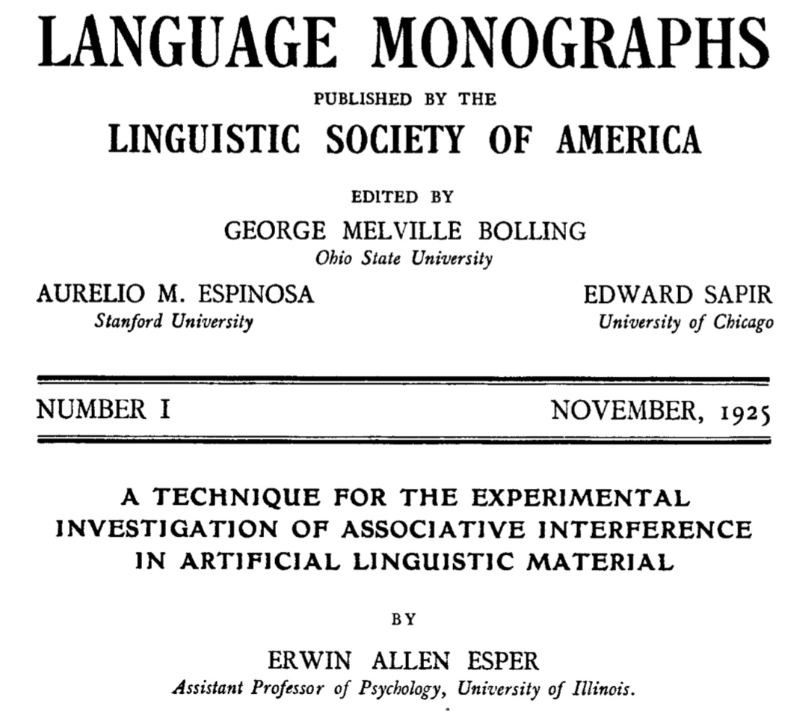
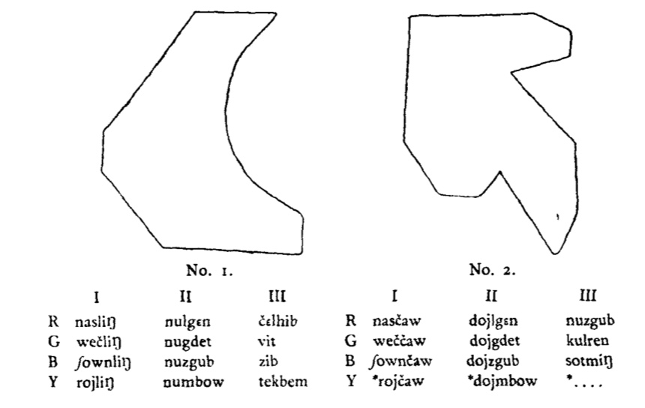
Overview
Artificial Language Learning
What is artificial language learning?
Esper (1925)

Slide 14
Overview
Artificial Language Learning
What is artificial language learning?
Köhler (1929)

Slide 15
Overview
Experimental diachronics
What is language evolution?
Schleicher (1863)

Slide 16
Overview
Experimental diachronics
What is language evolution?
Gray et al., 2010

Slide 17
Motivations
Experimental diachronics
Why study language evolution?
http://www.nytimes.com/2007/11/01/science/01chimp.html
Notes:
Human unique language – no other communication system in animals

Slide 18
Motivations
Experimental diachronics
Why study language evolution?
Rise of the Planet of the Apes (2011)

Slide 19
Motivations
Experimental diachronics
Why study language evolution?
haha
lol
aaaaaa
*grunt*
$%£#

Slide 20
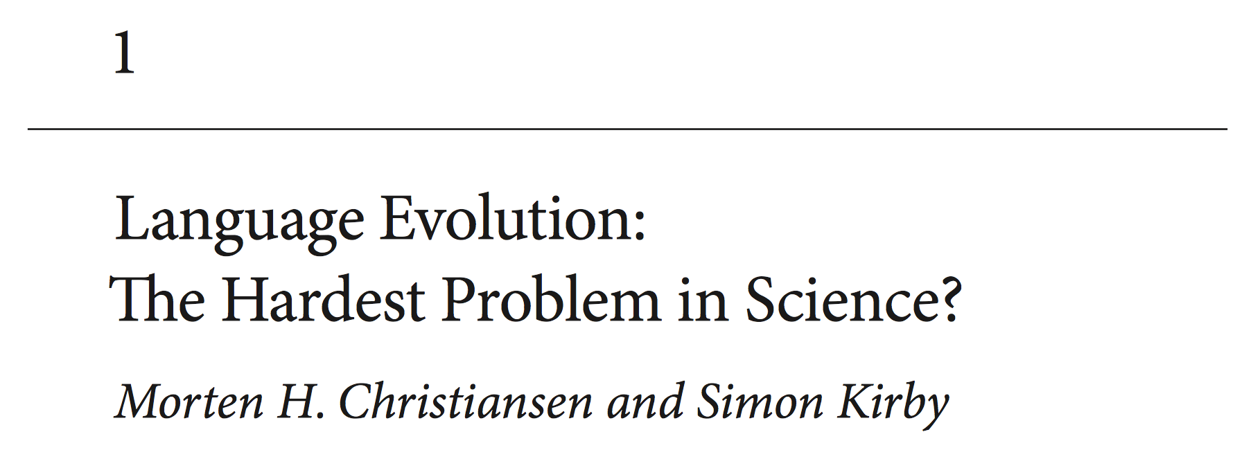
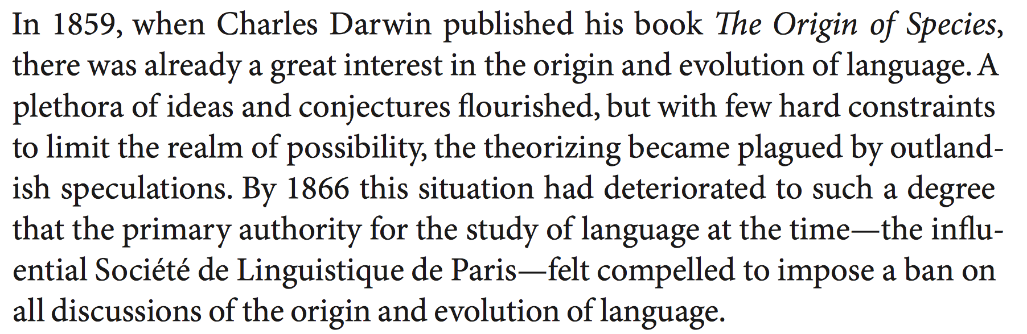
Motivations
Experimental diachronics
Why study language evolution?
Christiansen & Kirby (2003)

Slide 21
Methods
Experimental diachronics
How to study language evolution
https://startlediguana.files.wordpress.com/2013/10/boule_skulls.gif

Slide 22
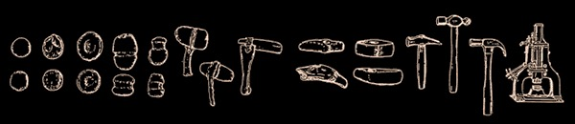
Methods
Experimental diachronics
How to study language evolution
Basalla (1988)

Slide 23
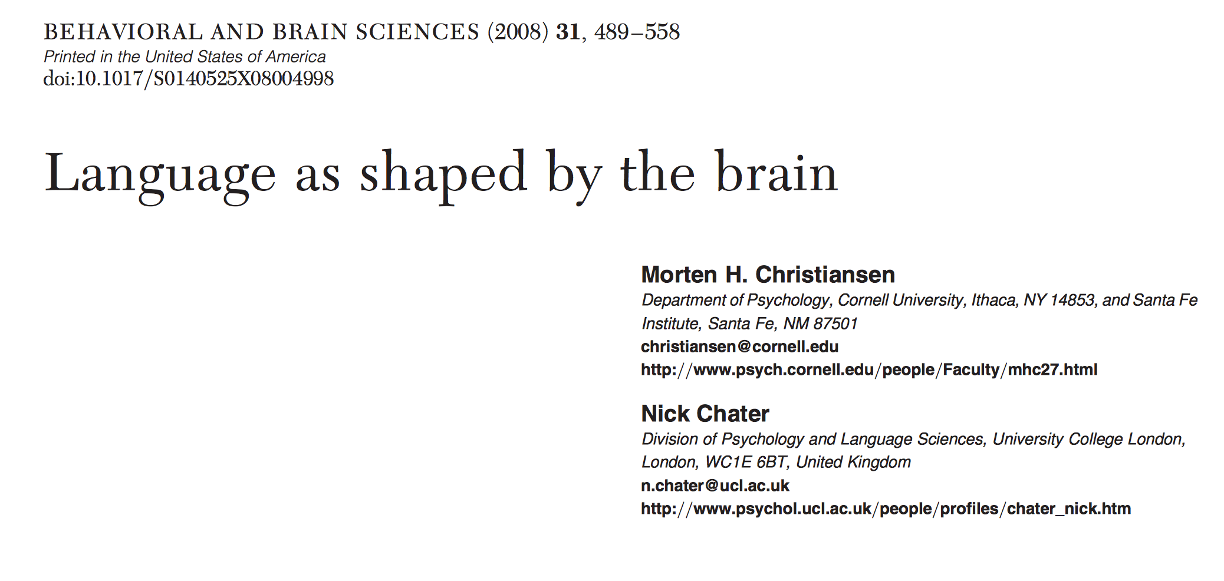
Methods
Experimental diachronics
How to study language evolution
Christiansen & Chater (2008)
Notes:
Evolution of cognition – leads to learning biases Learning biases shape culture

Slide 24
Methods
Experimental diachronics
How to study language evolution
Notes:
Evolution of cognition – leads to learning biases Learning biases shape culture

Slide 25
Methods
Experimental diachronics
How to study language evolution
1 8 5 0 3 7 6 2 4 9
Notes:
Evolution of cognition – leads to learning biases Learning biases shape culture

Slide 26
Methods
Experimental diachronics
How to study language evolution
Notes:
Evolution of cognition – leads to learning biases Learning biases shape culture

Slide 27
Methods
Experimental diachronics
How to study language evolution
0 1 2 3 4 5 6 7 8 9
Notes:
Evolution of cognition – leads to learning biases Learning biases shape culture

Slide 28
Methods
Experimental diachronics
How to study language evolution
Notes:
Evolution of cognition – leads to learning biases Learning biases shape culture

Slide 29
Methods
Experimental diachronics
How to study language evolution
icuetfsogrisoslimsncmhlou
Notes:
Evolution of cognition – leads to learning biases Learning biases shape culture

Slide 30
Methods
Experimental diachronics
How to study language evolution
Notes:
Evolution of cognition – leads to learning biases Learning biases shape culture

Slide 31
Methods
Experimental diachronics
How to study language evolution
summerschooloflinguistics
Notes:
Evolution of cognition – leads to learning biases Learning biases shape culture

Slide 32
Methods
Experimental diachronics
How to study language evolution
Notes:
Evolution of cognition – leads to learning biases Learning biases shape culture

Slide 33
Methods
Experimental diachronics
How to study language evolution
http://www.replicatedtypo.com/iterated-learning-using-youtube-videos/6093.html
Notes:
Evolution of cognition – leads to learning biases Learning biases shape culture

Slide 34
Methods
Experimental diachronics
How to study language evolution
Arrival (2016)
Notes:
Evolution of cognition – leads to learning biases Learning biases shape culture

Slide 35



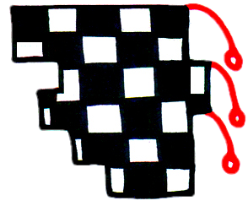
Methods
Experimental diachronics
How to study language evolution
gahemi
hekipo
kilonu
lenoga
Brand & Monaghan (in prep)
Notes:
Evolution of cognition – leads to learning biases Learning biases shape culture

Slide 36
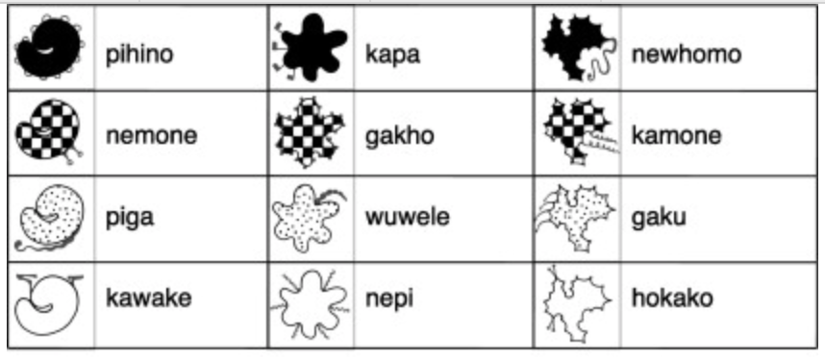
Methods
Experimental diachronics
How to study language evolution
Generation 1
Kirby, Tamariz, Cornish & Smith (2015)
Notes:
Evolution of cognition – leads to learning biases Learning biases shape culture

Slide 37
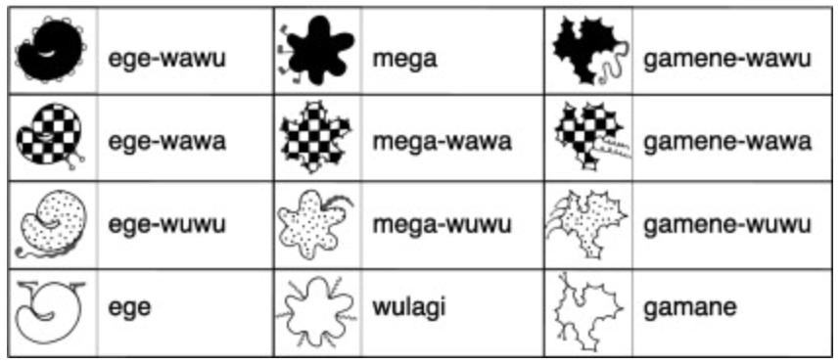
Methods
Experimental diachronics
How to study language evolution
Generation 10
Kirby, Tamariz, Cornish & Smith (2015)
Notes:
Evolution of cognition – leads to learning biases Learning biases shape culture

Slide 38
Methods
Experimental diachronics
How to study language evolution
Fehér et al (2017)
Notes:
Evolution of cognition – leads to learning biases Learning biases shape culture

Slide 39
Methods
Experimental diachronics
How to study language evolution
Claidière et al (2014)
Notes:
Evolution of cognition – leads to learning biases Learning biases shape culture

Slide 40
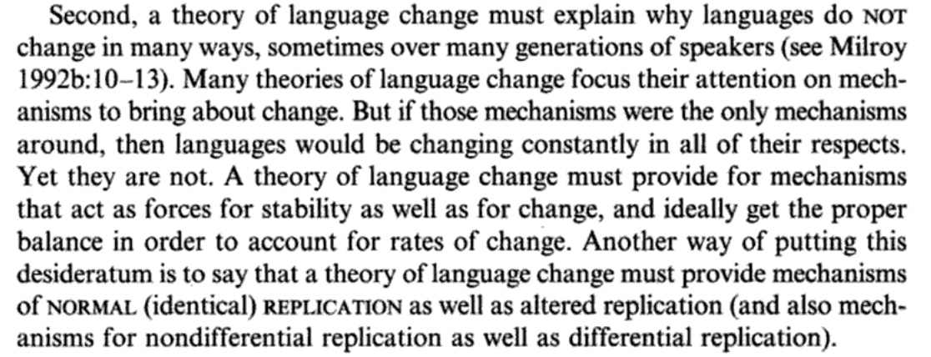
Findings
Experimental diachronics
Understanding why words change
Croft (2000, p.4)
Notes:
Evolution of cognition – leads to learning biases Learning biases shape culture

Slide 41
Findings
Experimental diachronics
Understanding why words change
mum
μαμά
mama
maman
mamá
butterfly
Πεταλούδα
schmetterling
papillon
mariposa
Notes:
Evolution of cognition – leads to learning biases Learning biases shape culture

Slide 42
Findings
Experimental diachronics
Understanding why words change
Ic ne secge
(Beowolf, 900)
Ic ne sege noht
(Ormulum, 1100)
I seye not
(Chaucer, 1400)
I doe not say
(Shakespeare, 1600)
I don’t say
(Woolf, 1900)
Dukelow (2017), Newberry (2017)
Notes:
Evolution of cognition – leads to learning biases Learning biases shape culture

Slide 43
Findings
Experimental diachronics
Understanding why words change
Notes:
Evolution of cognition – leads to learning biases Learning biases shape culture

Slide 44
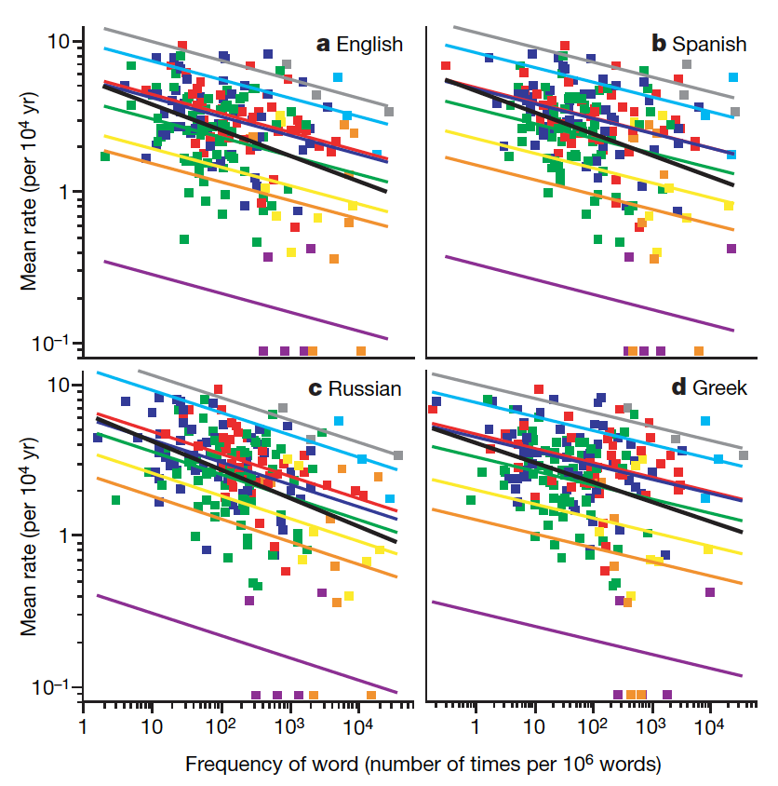
Findings
Experimental diachronics
Understanding why words change
Pagel, Atkinson & Meade (2007)
Notes:
Evolution of cognition – leads to learning biases Learning biases shape culture

Slide 45
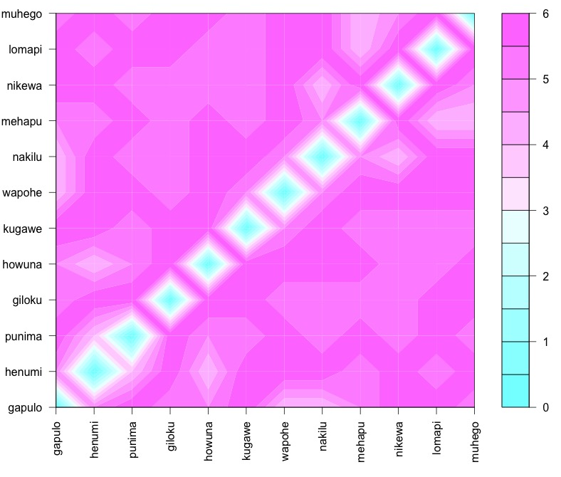
Findings
Experimental diachronics
Understanding why words change
Notes:
Evolution of cognition – leads to learning biases Learning biases shape culture

Slide 46
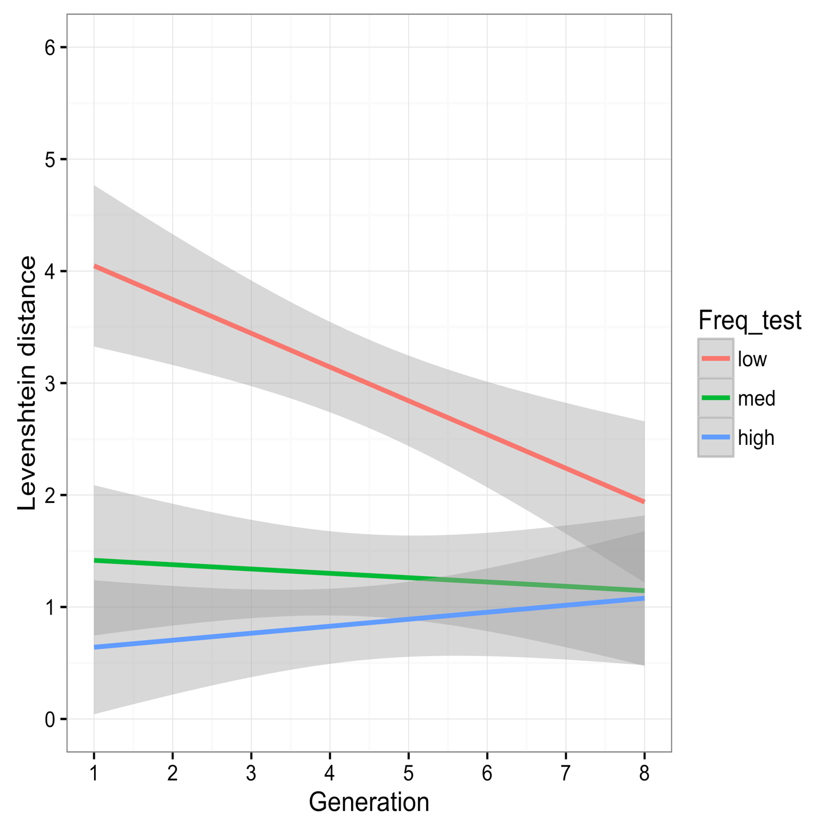
Findings
Experimental diachronics
Understanding why words change
Frequency | Generation 1 | Generation 7
low | giloku | mihewu
low | howuna | mihuge
low | kugawe | napiwa
low | lomapi | nokiwa
med | nakilu | lilipe
med | wapohe | lamupo
med | muhego | hewino
med | punima | wopehu
high | henumi | punima
high | gakulo | logopi
high | nipewa | henumi
high | mehapu | gakulo
Brand & Monaghan (in prep)
Notes:
Evolution of cognition – leads to learning biases Learning biases shape culture

Slide 47
Findings
Experimental diachronics
Understanding why words change
Word length
Semantics
Age of acquisition
Grammatical categories
Notes:
Evolution of cognition – leads to learning biases Learning biases shape culture

Slide 48
Findings
Experimental diachronics
Conclusions
What you have learnt today:
What language evolution is
Why we study it
How to study it
What studying it has shown us
Why multi-disciplinary research is important
Notes:
Evolution of cognition – leads to learning biases Learning biases shape culture

Slide 49
Questions/ ?
j.brand@lancaster.ac.uk
Notes:
Evolution of cognition – leads to learning biases Learning biases shape culture

Slide 50
Further reading
Croft, W. (2000). Explaining language change: An evolutionary approach. Pearson Education.
Christiansen, M. H., & Kirby, S. (Eds.). (2003). Language evolution. OUP Oxford.
Christiansen, M. H., & Chater, N. (2008). Language as shaped by the brain. Behavioral and brain sciences, 31(5), 489-509.
Darwin, C. (1888). The descent of man and selection in relation to sex (Vol. 1). Murray.
Fehér, O., Ljubičić, I., Suzuki, K., Okanoya, K., & Tchernichovski, O. (2017). Statistical learning in songbirds: from self-tutoring to song culture. Phil. Trans. R. Soc. B, 372(1711), 20160053.
Kirby, S., Tamariz, M., Cornish, H., & Smith, K. (2015). Compression and communication in the cultural evolution of linguistic structure. Cognition, 141, 87-102.
Pagel, M., Atkinson, Q. D., & Meade, A. (2007). Frequency of word-use predicts rates of lexical evolution throughout Indo-European history. Nature, 449(7163), 717.
Notes:
Evolution of cognition – leads to learning biases Learning biases shape culture

